Slide 1

DEPARTMENT OF COMPUTER SCIENCE AND ENGINEERING CMR TECHNICAL CAMPUS 2019-2023 A Major Project on CONTROL OF ACCESS TO ENCRYPTED CLOUD STORAGE
Under the Guidance of
Rakshitha Okali
(Assistant Professor)
Presented by-
P. Sai Preethi (197R1A05N9)
N. Preethi (197R1A05N6)
A. Chandrika (197R1A05J3)

Slide 2
ABSTRACT
Cloud computing has become a popular way to store data, but many people are concerned about entrusting sensitive information to cloud providers who may not provide enough user control. To address this, many data owners choose to outsource encrypted data using Ciphertext-Policy Attribute-based Encryption (CP-ABE) for fine-grained access control. However, previous schemes have not adequately protected against Economic Denial of Sustainability (EDoS) attacks, where attackers can consume cloud resources and cost the payer a great deal of money. This lack of transparency and accountability is a major concern for data owners. In response, your proposal aims to secure encrypted cloud storage from EDoS attacks and provide resource consumption accountability by using CP-ABE schemes in a black-box manner that complies with the arbitrary access policies of CP-ABE. You have presented two protocols for different settings and conducted performance and security analyses to demonstrate the effectiveness and efficiency of the proposed solution.

Slide 3
EXISTING SYSTEM
In the existing system, R. K. Ko et.al., the authors discussed key issues and challenges about how to achieve accountability in cloud computing.
In the literature, D. O´. Coilea´et.al.,the authors surveyed existing accounting and accountability in content distribution architectures.
V. Sekaret.al. and C. Chen et. al., the authors respectively proposed a systematic approach for verifiable resource accounting in cloud computing.

Slide 4
DISADVANTAGES
The accounting approach involves changes to the system model, and requires the anonymous verification of users, which is not supported in previous systems.
The access control is only available for data owners, which turns out to be insufficient.
This makes the storage system vulnerable to the resource-exhaustion attacks.
It loses the flexibility of access control from CP-ABE.

Slide 5
PROPOSED SYSTEM
The security requirements of the system are achieved through two key components:
A cloud-side access control mechanism that blocks users whose attribute set does not meet the access policy A;
A proof-collecting subsystem that allows the cloud provider to collect proofs of resource consumption from users and present them to the data owner later.
Real-world scenarios often involve specifying a maximum expected download time, and data owners can remain offline unless they choose to increase this value. The first protocol, Partially Outsourced Protocol (POP), is designed to address such scenarios. In cases where the data owner cannot set expectations for download times or would be offline for an extended period, the Fully Outsourced Protocol (FOP) can be utilized, allowing the data owner to delegate control to the cloud.

Slide 6
ADVANTAGES
We propose a general solution to secure encrypted cloud storage to prevent the EDoS attacks, as well as have fine-grained access control and resource consumption accountability.
For different data owner online patterns and performance concern, we provide two protocols for authentication and resource consumption accounting.
We also introduce the bloom filter and the probabilistic check to improve the efficiency but still guarantee the security.
Compared with many state-of-arts constructions of encrypted cloud storage that assume the existence of a semi-honest cloud provider, we use a more practical threat model.
Compared with relevant schemes, our approach works on the protocol level to provide the resource verifiability that relies on authorized users who satisfy the CP-ABE policy, and achieves the covert security which is more practical and secure.

Slide 7
HARDWARE REQURIEMENTS
System : Pentium IV 2.4 GHz.
Hard Disk : 40 GB.
Floppy Drive : 1.44 Mb.
Monitor : 15 VGA Colour.
Mouse : Logitech.
Ram : 512 Mb.

Slide 8
SOFTWARE REQURIEMENTS
Operating System : Windows 10
Technology : Java 2 Standard Edition, JDBC
Web Server : Tomcat 7.0
Editor : NetBeans8.1

Slide 9
NOVELTY
People endorse the great power of cloud computing but cannot fully trust the cloud providers to host privacy-sensitive data, due to the absence of user-to-cloud controllability. In order to secure encrypted cloud storages from EDoS attacks and provide resource consumption accountability. For different data owner online patterns and performance concern, we provide two protocols for authentication and resource consumption accounting.

Slide 10
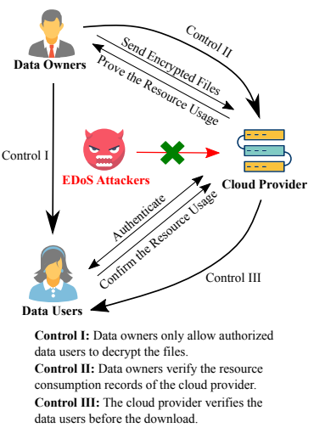
ARCHITECTURE
Figure: Project architecture of encrypted cloud storage

Slide 11
MODULE
Ciphertext-Policy Attribute-Based Encryption(CP-ABE)
Economic Denial of Sustainability(EDoS)
Distribution Denial of Sustainability(DDoS)
Here we are using two protocols:
Partially Outsourced Protocol (POP) (V-B)
Fully Outsourced Protocol (FOP) (V-C)

Slide 12
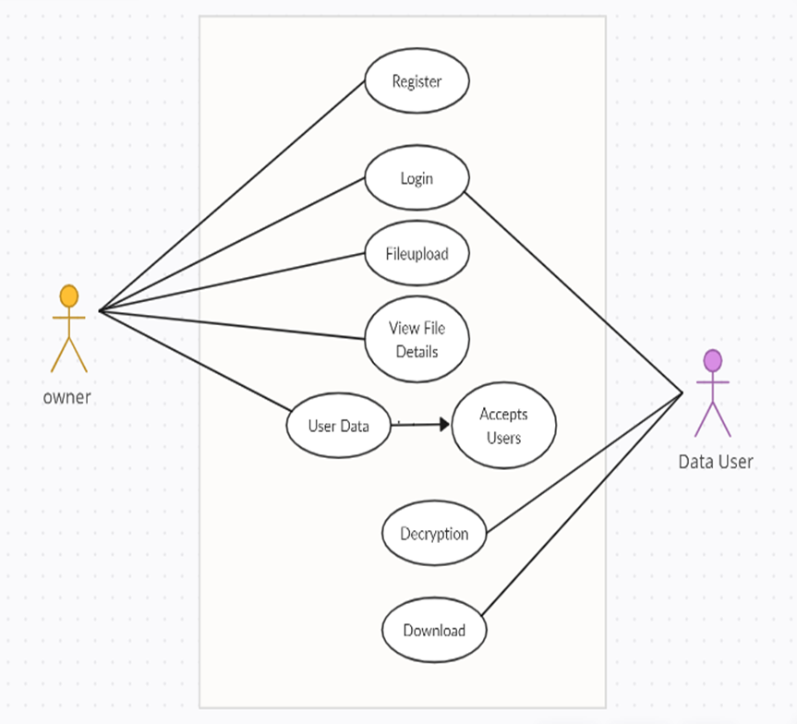
USE CASE DIAGRAM

Slide 13
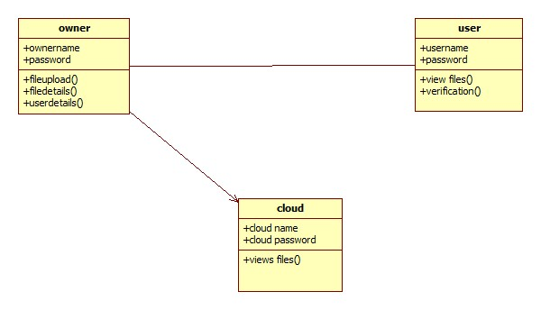
CLASS DIAGRAM

Slide 14
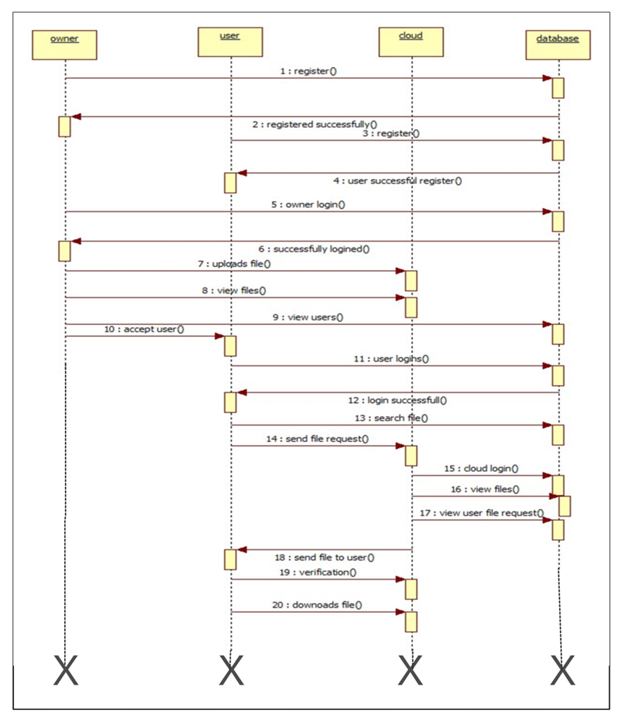
SEQUENCE DIAGRAM

Slide 15
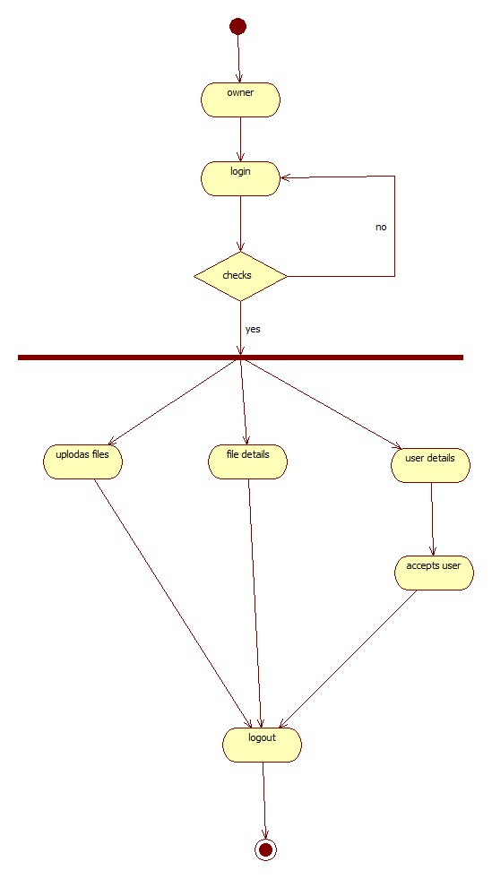
ACTIVITY DIAGRAM

Slide 16
SAMPLE CODE
Owner.java
package com;
import java.io.IOException;
import java.io.PrintWriter;
import javax.servlet.RequestDispatcher;
import javax.servlet.ServletException;
import javax.servlet.http.HttpServlet;
import javax.servlet.http.HttpServletRequest;
import javax.servlet.http.HttpServletResponse;
import javax.servlet.http.HttpSession;
public class Owner extends HttpServlet {
public void doPost(HttpServletRequest request, HttpServletResponse response) throws ServletException, IOException {
response.setContentType("text/html");
HttpSession session=request.getSession();
PrintWriter out = response.getWriter();
String user=request.getParameter("t1");
String pass=request.getParameter("t2");
try{
String input[]={user,pass};
String msg=DBConnection.ownerLogin(input);
if(msg.equals("success")){
session.setAttribute("user",user);
RequestDispatcher rd=request.getRequestDispatcher("OwnerScreen.jsp?t1=Welcome "+user);
rd.forward(request, response);

Slide 17
public void doPost(HttpServletRequest request, HttpServletResponse response) throws ServletException, IOException {
response.setContentType("text/html");
HttpSession session=request.getSession();
PrintWriter out = response.getWriter();
String user=request.getParameter("t1");
String pass=request.getParameter("t2");
try{
String input[]={user,pass};
String msg=DBConnection.ownerLogin(input);
if(msg.equals("success")){
session.setAttribute("user",user);
RequestDispatcher

Slide 18
rd=request.getRequestDispatcher("OwnerScreen.jsp?t1=Welcome "+user);
rd.forward(request, response);
} else {
response.sendRedirect("Owner.jsp?t1=Invalid User");
}
}catch(Exception e){
e.printStackTrace();
}
}
}

Slide 19
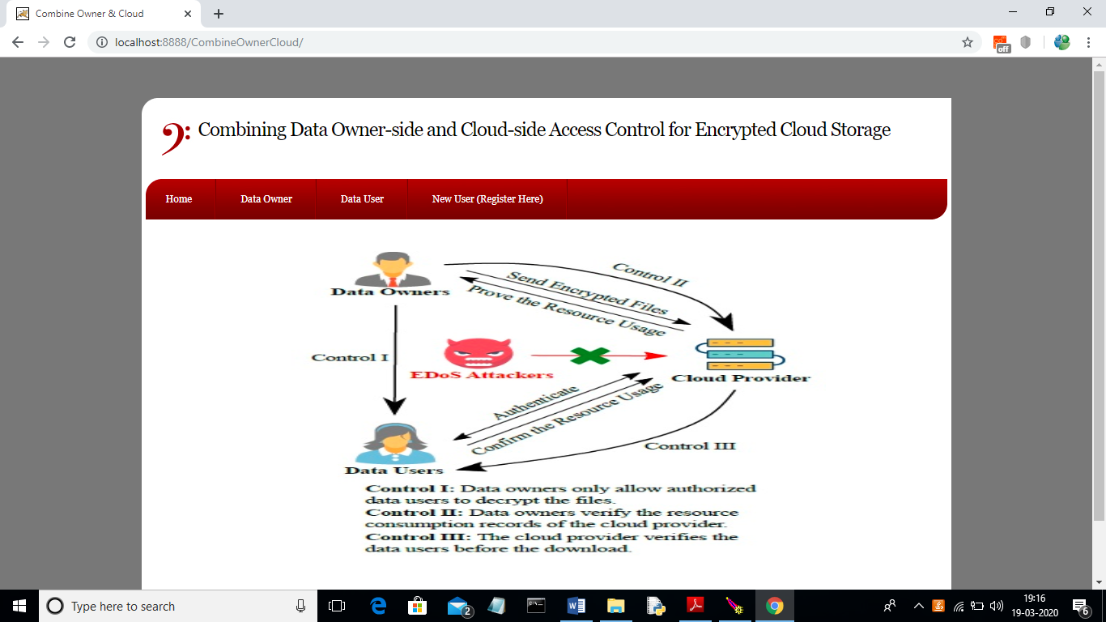
RESULTS
Control of Access to Encrypted Cloud Storage
Screenshot : Home page to add data owner and user

Slide 20
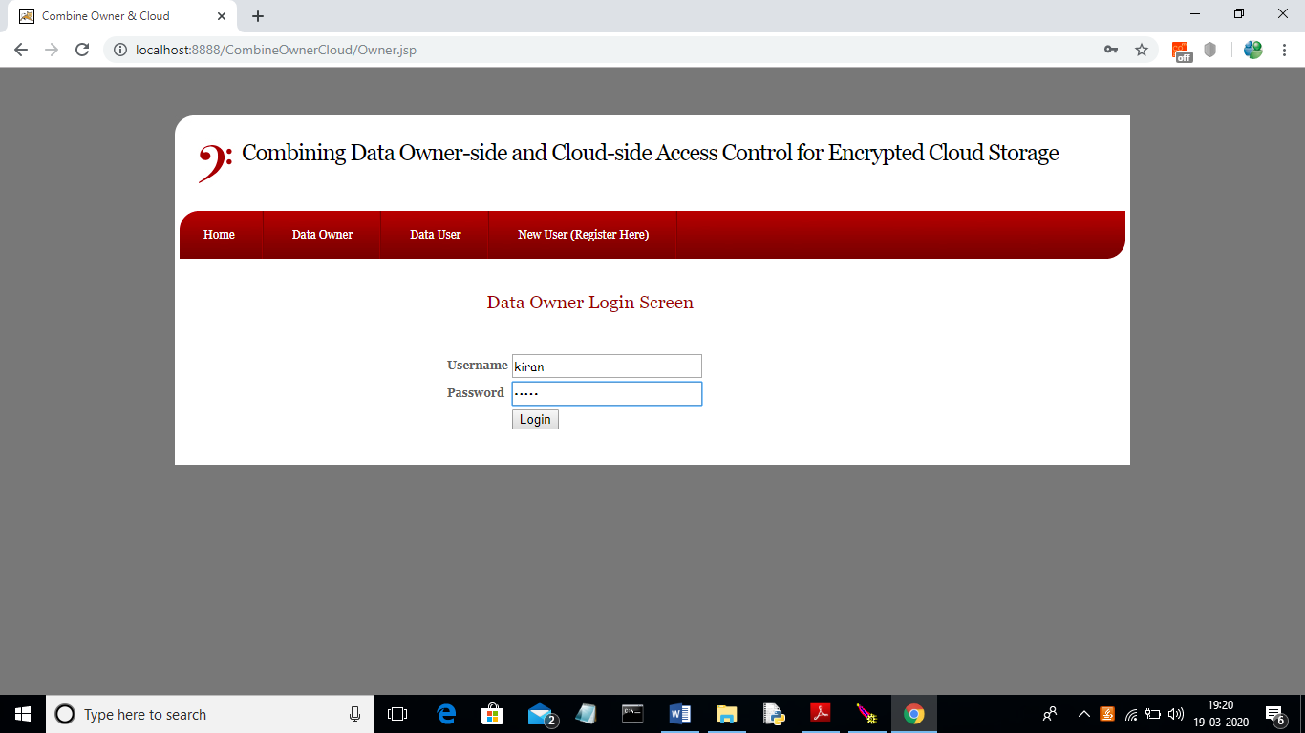
Control of Access to Encrypted Cloud Storage
Screenshot : Data owner login

Slide 21
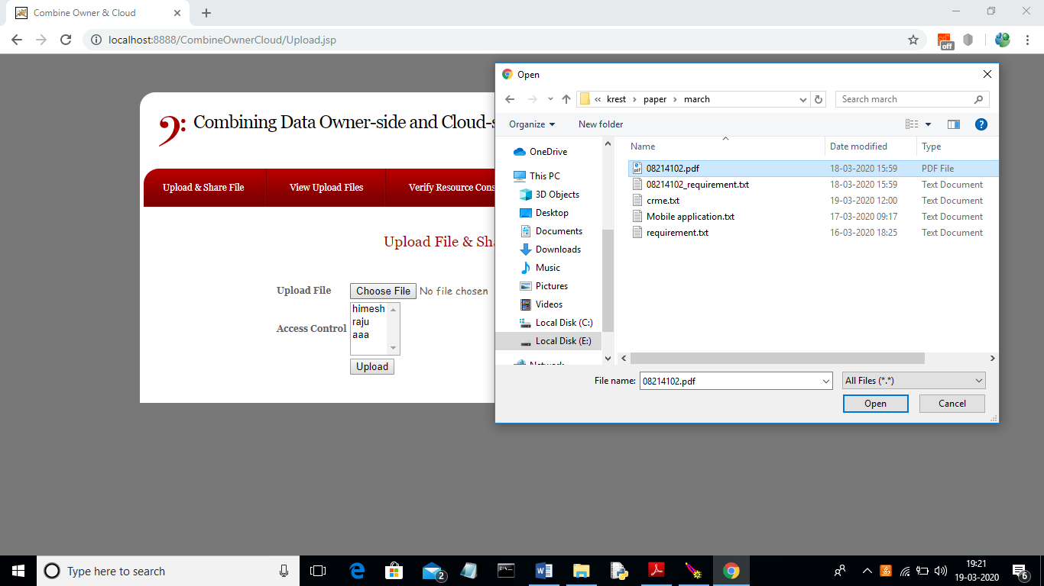
Control of Access to Enc
Screenshot: Uploading the files

Slide 22

Control of Access to Encrypted cloud Storage
Screenshot: Data user login

Slide 23
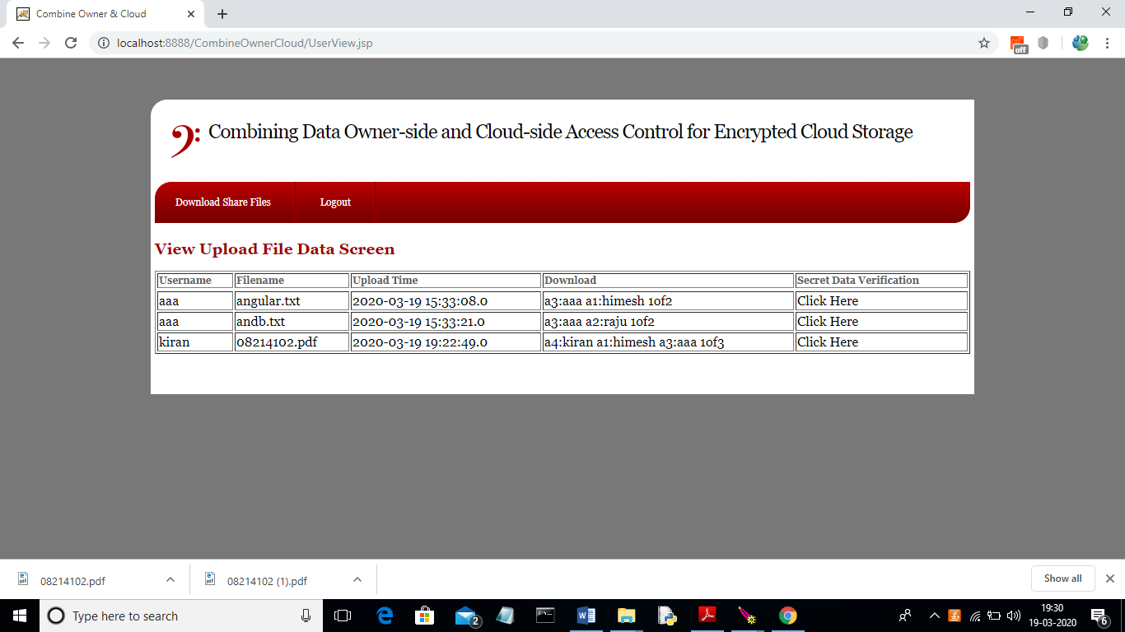
Control of Access to Encrypted Clous Storage
Screenshot: User requesting for file

Slide 24
CONCLUSION
Our proposed project aims to enhance the security of encrypted cloud storage by combining access control measures both at the cloud and data owner sides. This approach is designed to resist Distributed Denial of Service (DDoS) and Extreme Denial of Service (EDoS) attacks while also providing resource consumption accounting. Our system can support arbitrary Conjunctional Policy Attribute-Based Encryption (CP-ABE) constructions, which are secure against malicious data users and covert cloud providers. We have relaxed the security requirements for the cloud provider to accommodate covert adversaries, a more practical and relaxed notion compared to semi-honest adversaries. To optimize resource consumption accounting and reduce overhead, we utilize bloom filters and probabilistic checks. Based on our performance analysis, our approach offers small overhead compared to existing systems.

Slide 25
FUTURE ENHANCEMENT
In this research work, we aim to develop a novel approach for ensuring secure file storage in the cloud, while preventing unauthorized access by other users. The proposed method involves encrypting the files and storing them in a secure cloud-based environment. This ensures that only authorized users are able to access the files and eliminates the risk of data breaches or unauthorized data access. The approach is expected to have significant benefits for organizations and individuals who store sensitive data in the cloud, by providing a secure and efficient means of managing their data.

Slide 26
REFERENCES
J. Bethencourt, A. Sahai, and B. Waters, “Ciphertext-policy attribute- based encryption,” in 2007 IEEE Symposium on Security and Privacy (SP’07). IEEE, 2007, pp. 321–334.
A. Sahai and B. Waters, “Fuzzy identity-based encryption,” in Advances in Cryptology–EUROCRYPT 2005. Springer, 2005, pp. 457–473.
V. Goyal, O. Pandey, A. Sahai, and B. Waters, “Attribute-based encryption for fine-grained access control of encrypted data,” in Proceedings of the 13th ACM conference on Computer and communications security (CCS2006). ACM, 2006, pp. 89–98.
S. Yu, C. Wang, K. Ren, and W. Lou, “Achieving secure, scalable, and fine-grained data access control in cloud computing,” in The 29th IEEE International Conference on Computer Communications (IEEE INFOCOM 2010). IEEE, 2010, pp. 1–9.
B. Waters, “Ciphertext-policy attribute-based encryption: An expressive, efficient, and provably secure realization,” in Public Key Cryptography– PKC 2011. Springer, 2011, pp. 53–70.

Slide 27
GITHUB LINK
https://github.com/Student-639/MAJOR-PROJECT

Slide 28
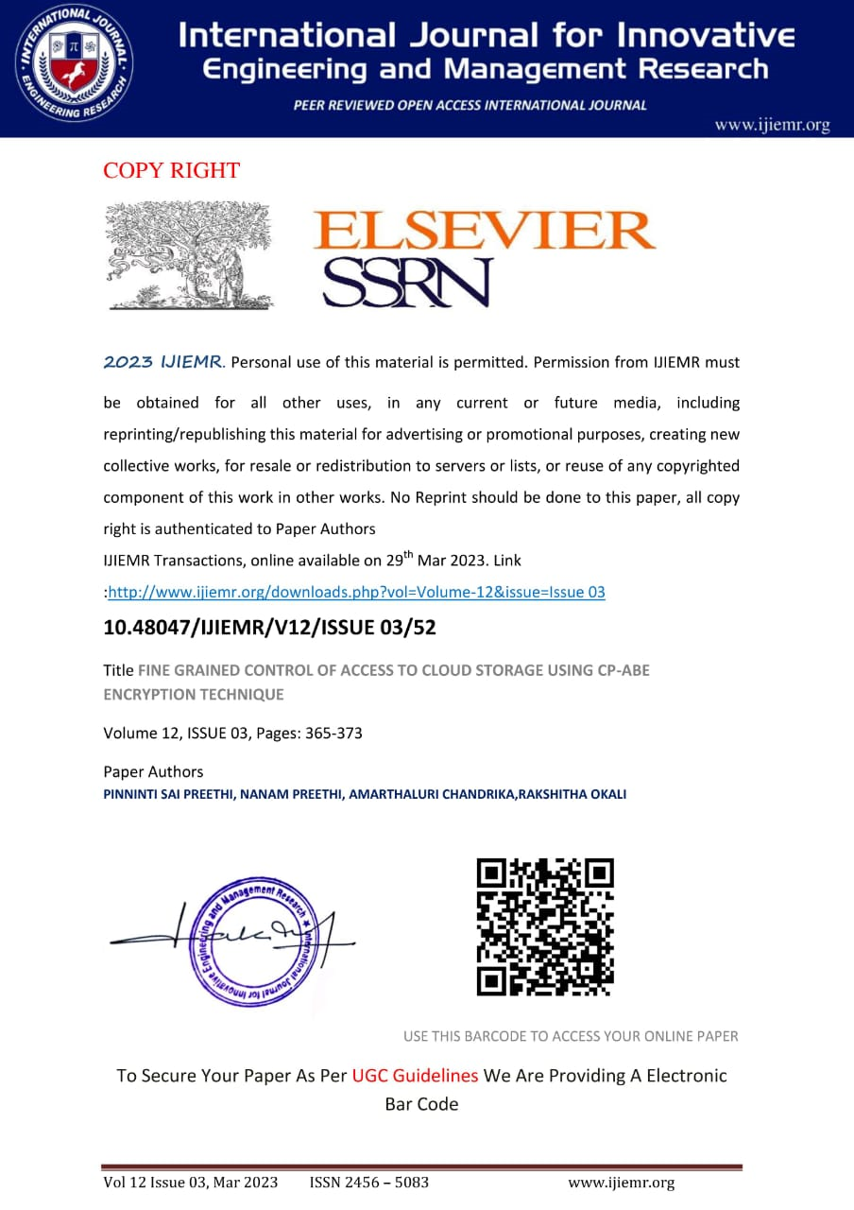
PAPER PUBLICATION

Slide 29
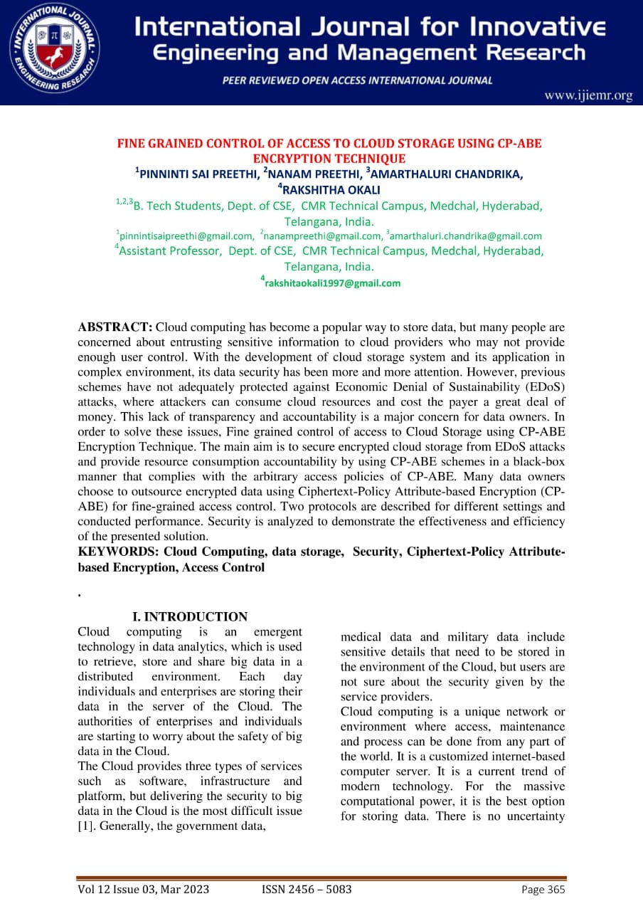

Slide 30
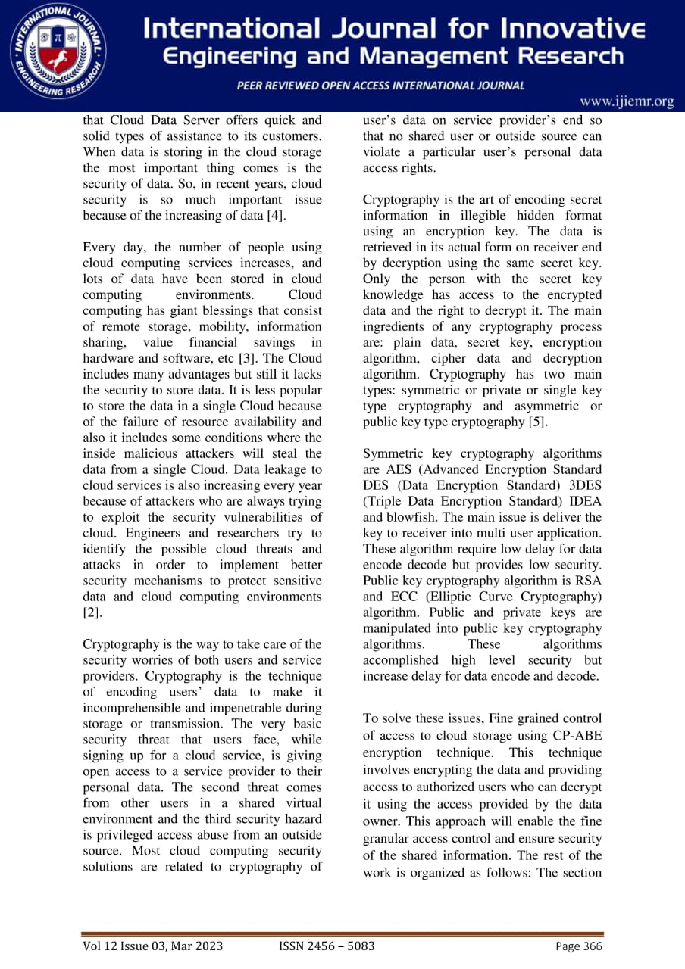

Slide 31
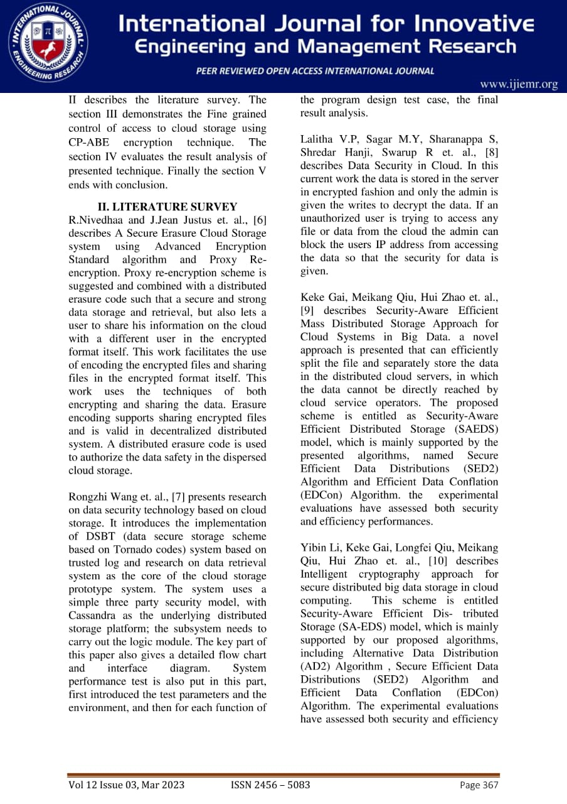

Slide 32
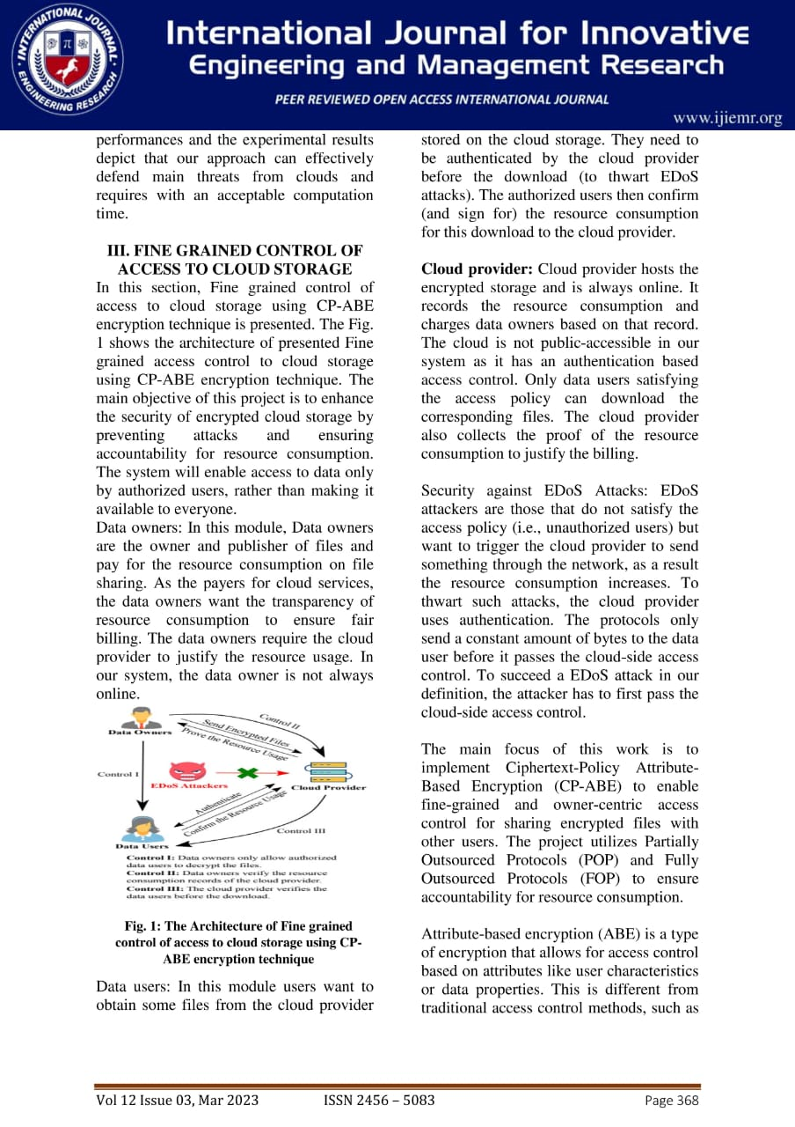

Slide 33
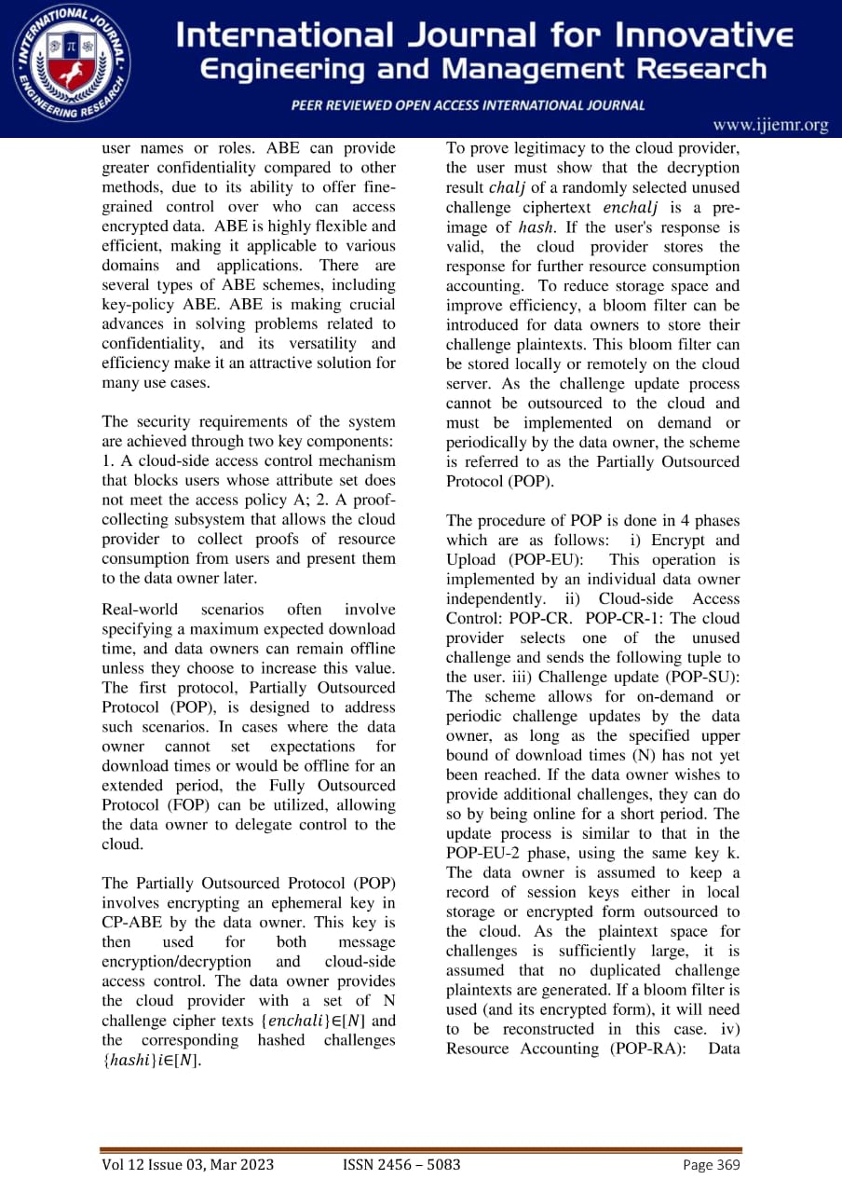

Slide 34
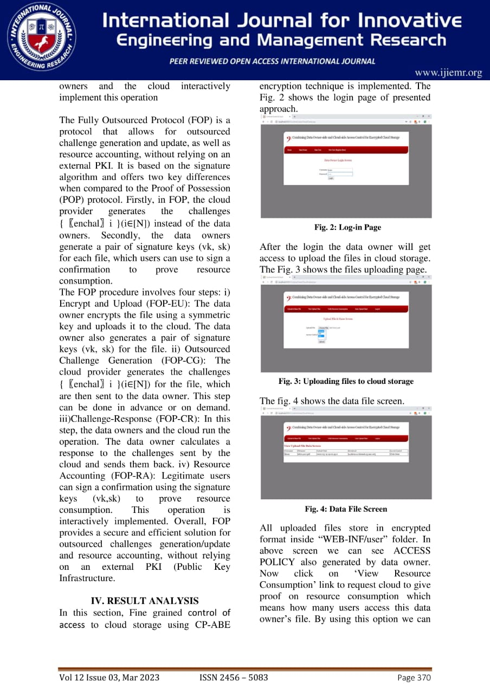

Slide 35
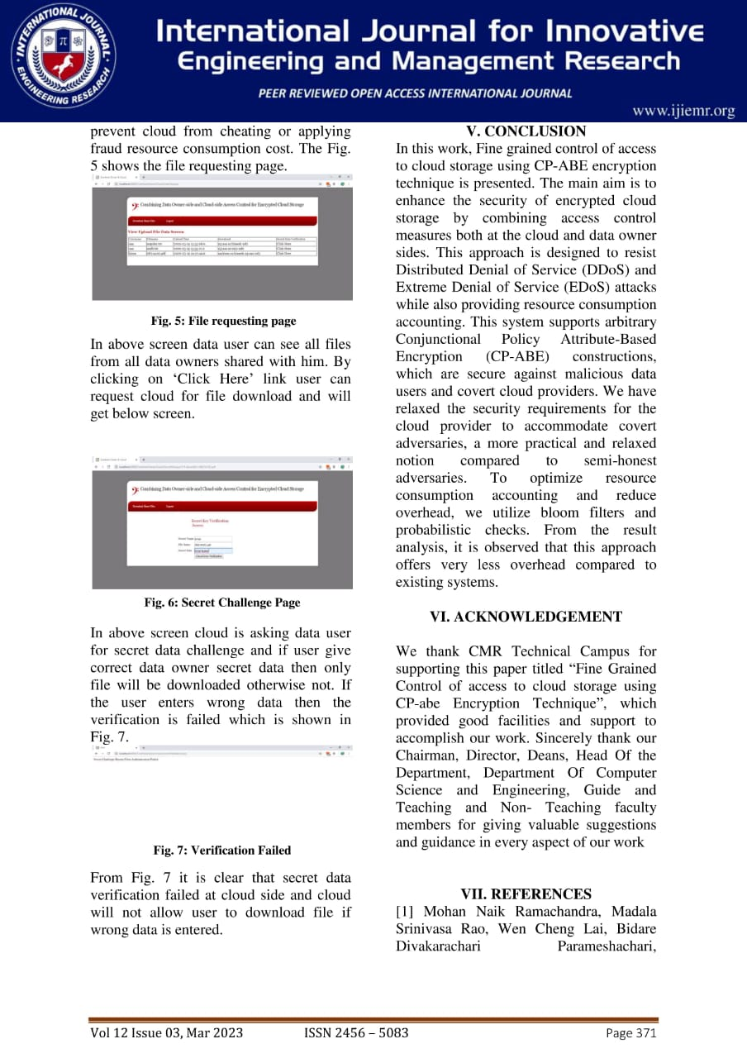

Slide 36
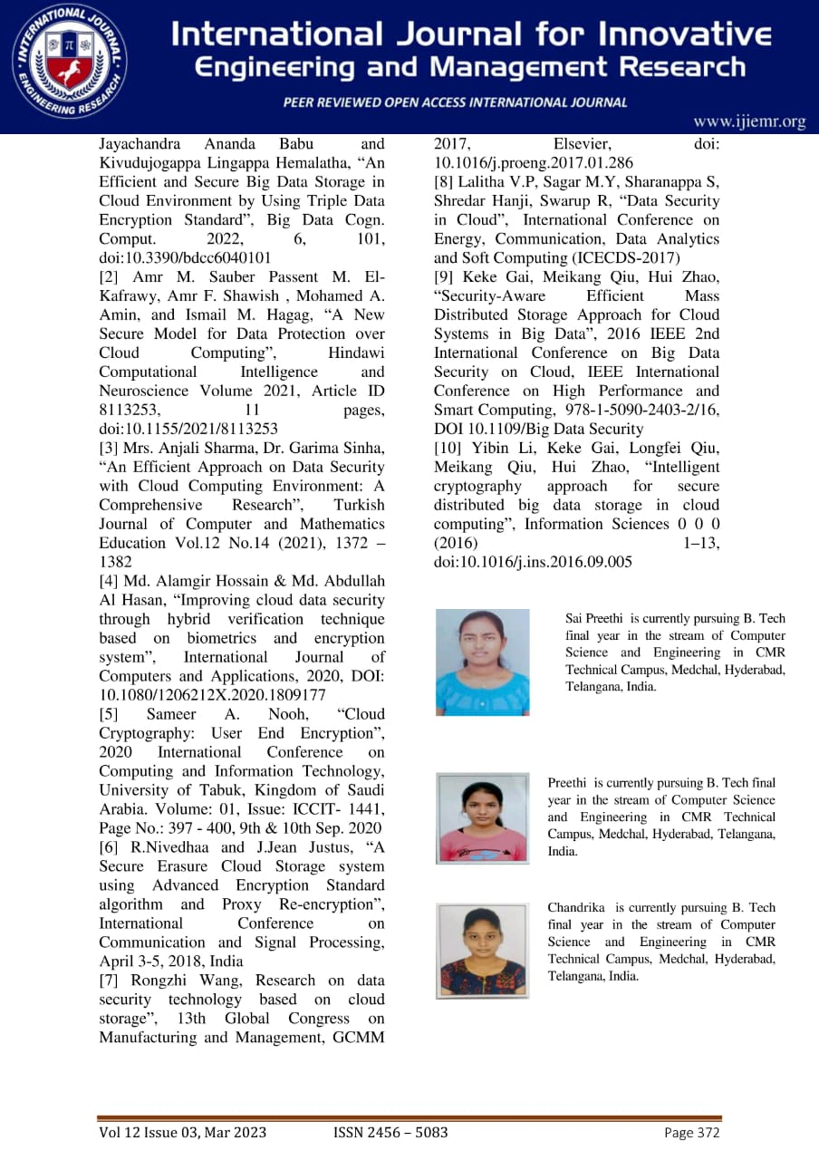
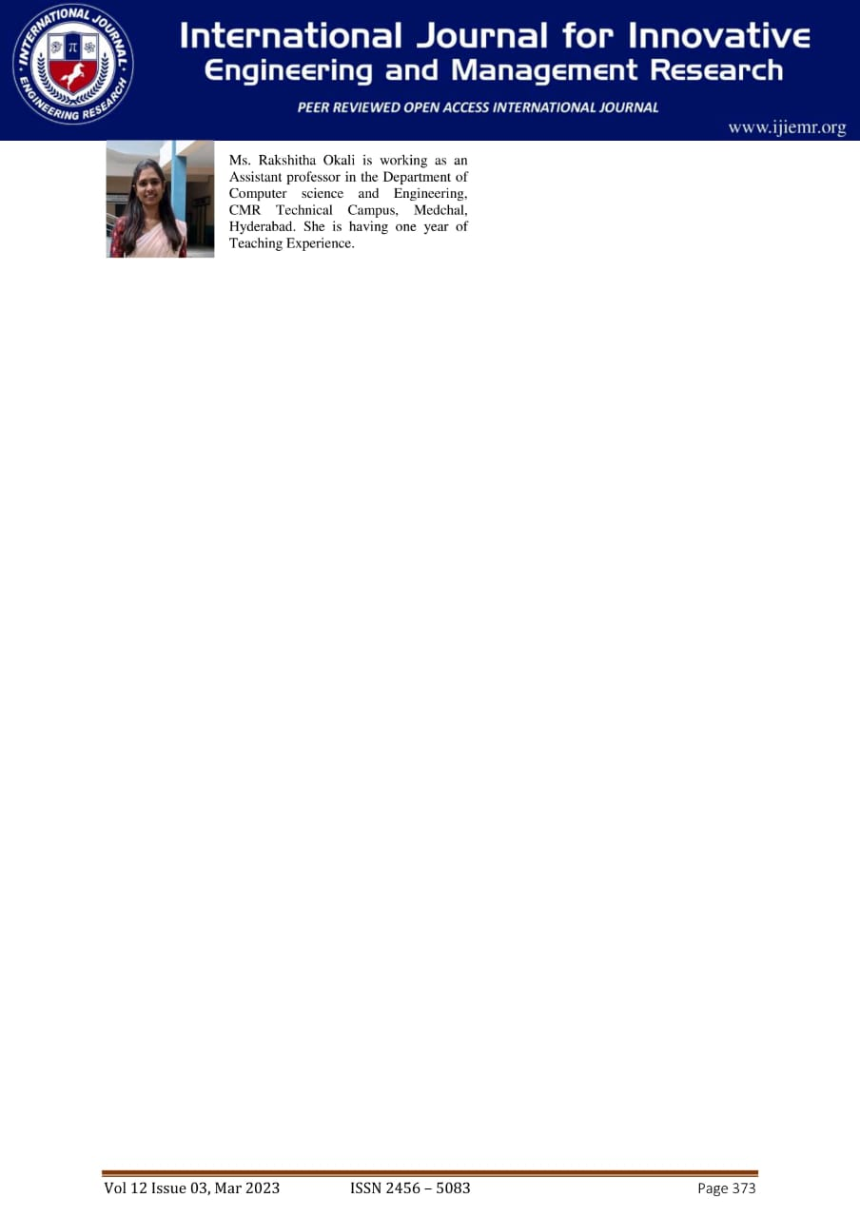

Slide 37
THANK YOU
Presented by-
P. Sai Preethi(197R1A05N9)
N. Preethi (197R1A05N6)
A. Chandrika (197R1A05J3)

